Slide 1
Outline
Transmission Line (Transient)
Transmission Line (Time Harmonic)
Reflection Coefficient
Smith Chart

Slide 2
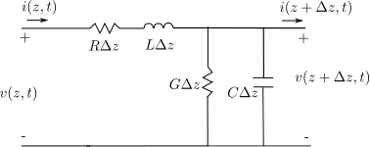
Telegraph Equations
KVL
KCL

Slide 3
Lossless (R = G = 0) T. Lines
Wave Equation
Phase Velocity
General Solution to Lossless T. Line Equation
Characteristic Impedance

Slide 4
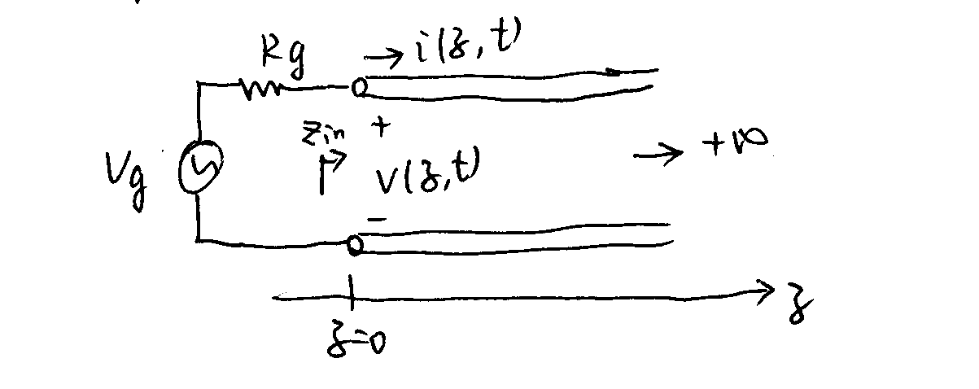
Semi-Infinite T. Line
Generated at z = 0 will travel in +z direction without reflection

Slide 5
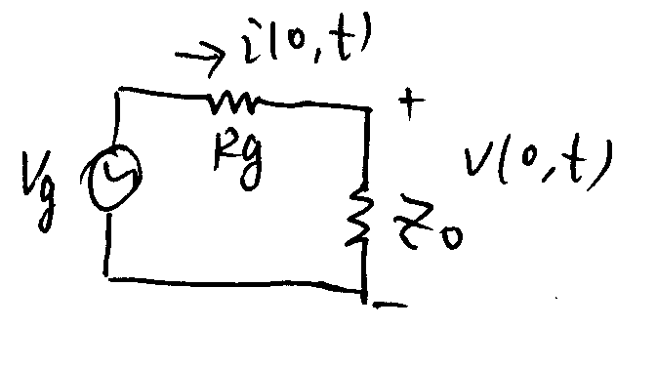
Semi-Infinite T. Line
At z = 0
A semi-infinite T. Line is seen by the voltage source as a load with an impedance of Z₀

Slide 6
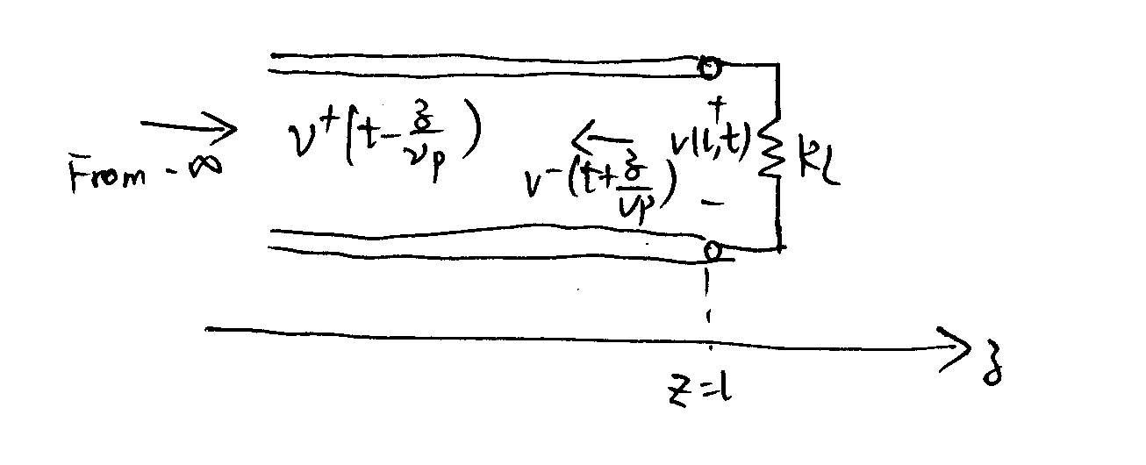
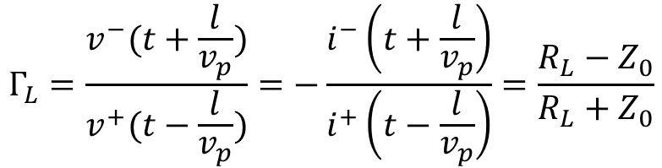
T. Line with Resistive Terminal
At z = l
Voltage Reflection Coefficient

Slide 7
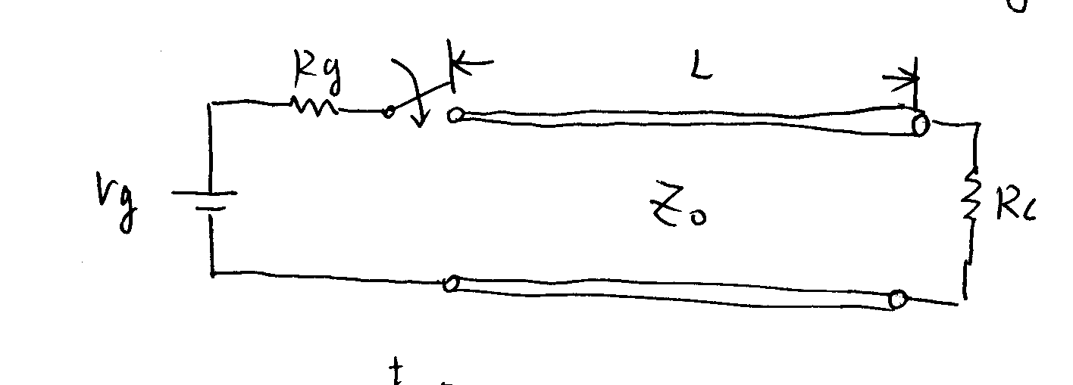
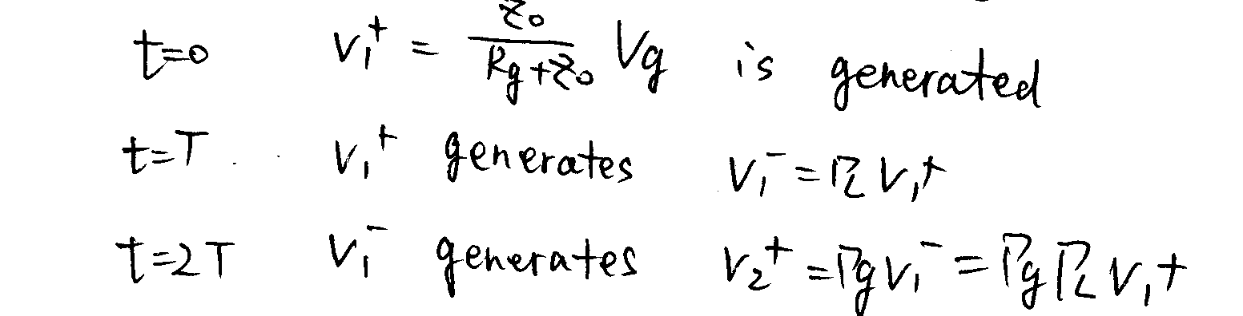
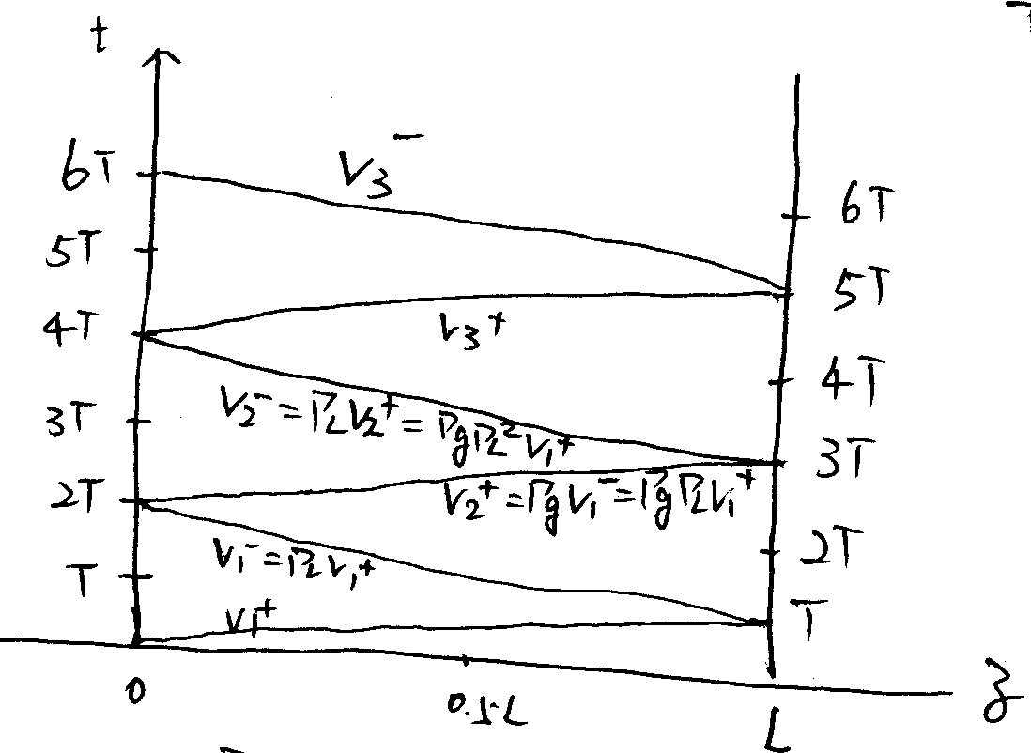
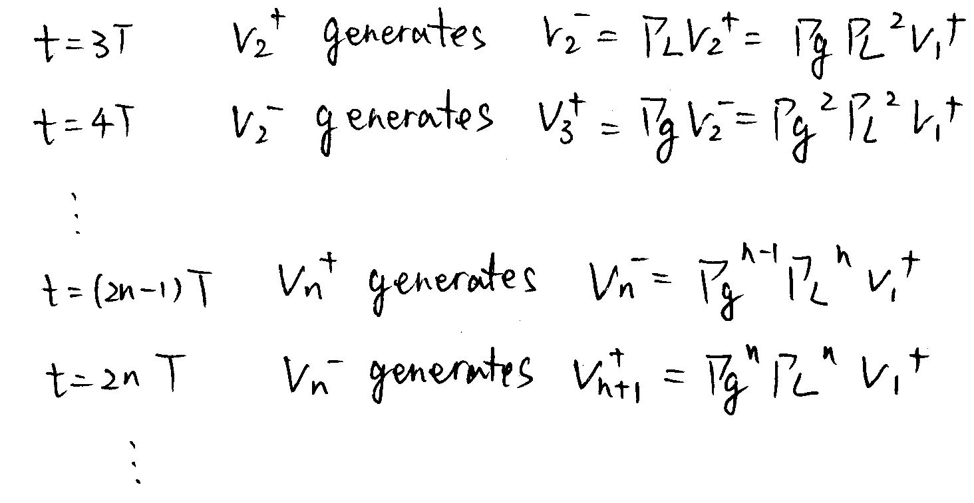
DC Transient Propagation Along T. Line

Slide 8
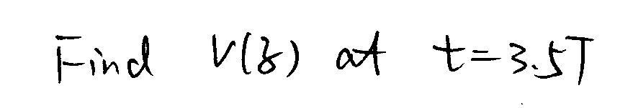
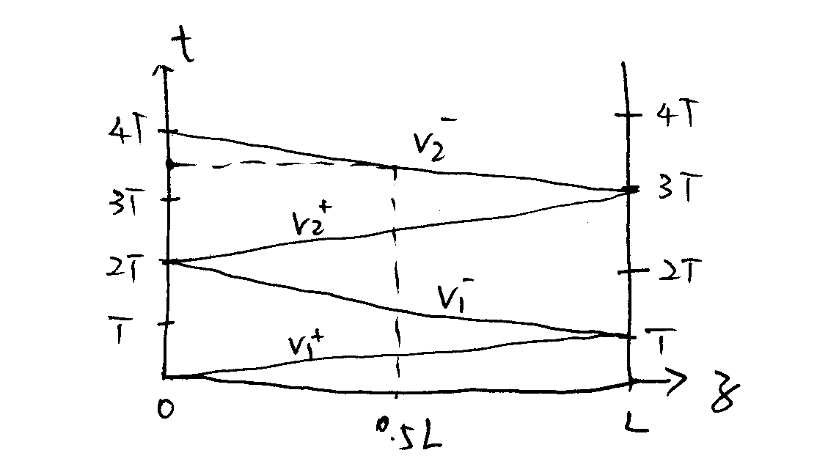
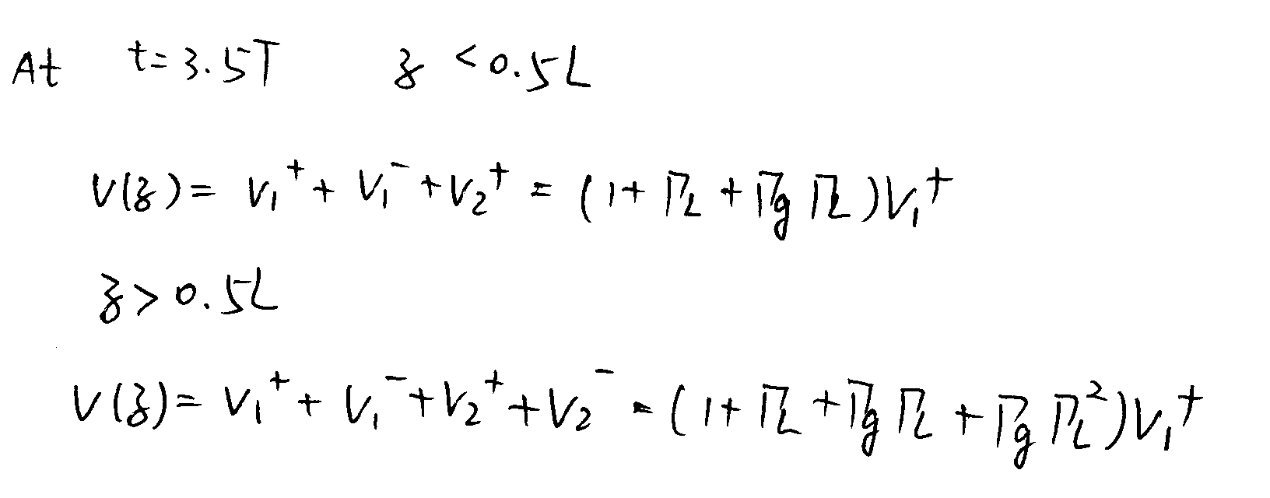
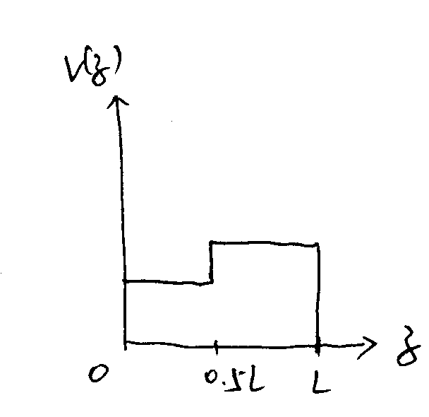
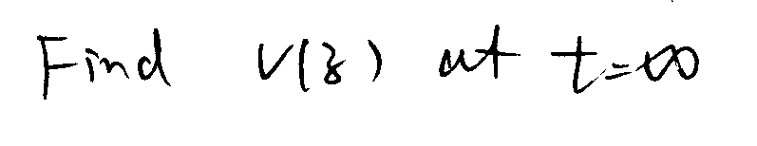
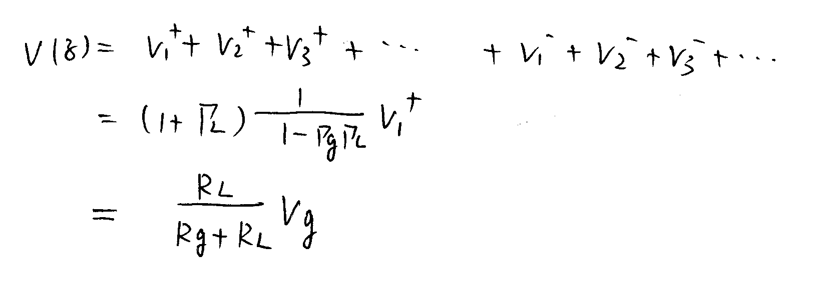
DC Transient Propagation Along T. Line

Slide 9
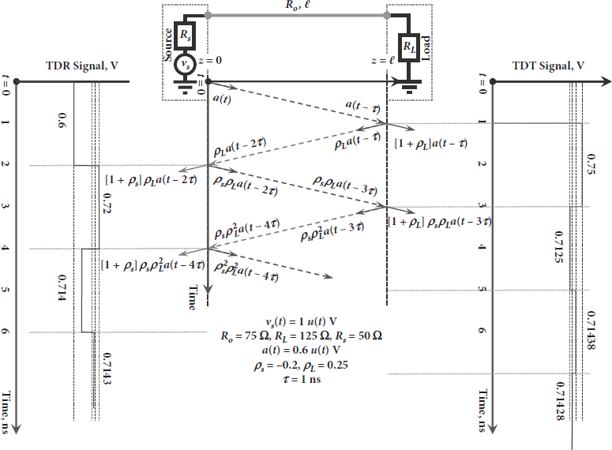
DC Transient Propagation Along T. Line

Slide 10
Time Harmonic T. Lines

Slide 11
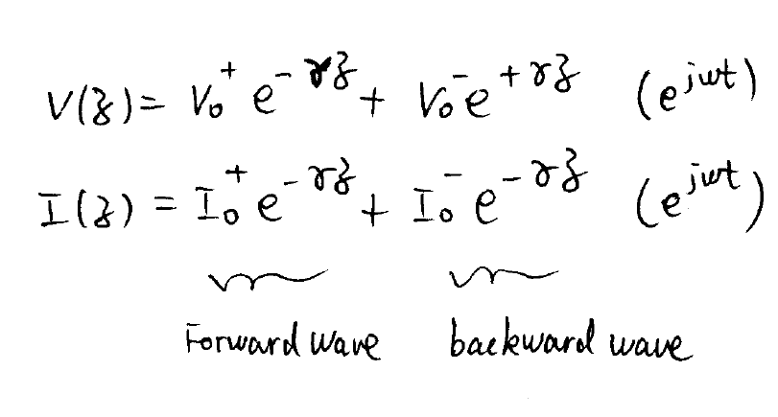
Time Harmonic T. Lines
Complex Propagation Constant
Attenuation Constant
Propagation Constant

Slide 12
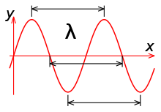
Time Harmonic T. Lines
Propagation
Attenuation
Phase Velocity
Wavelength

Slide 13
Characteristic Impedance
Lossless T. Line
Reflection Coefficient

Slide 14
Power
Incident Power
Reflected Power
Power Delivered to Load

Slide 15
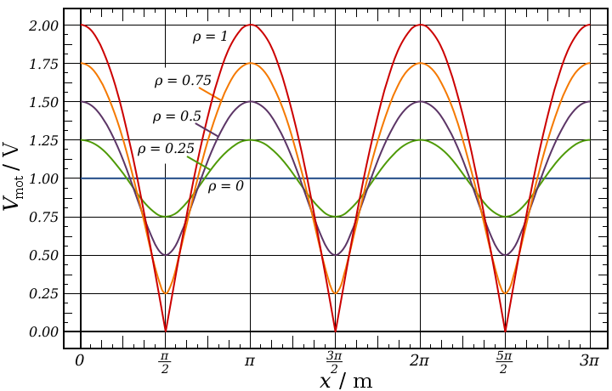
SWR

Slide 16
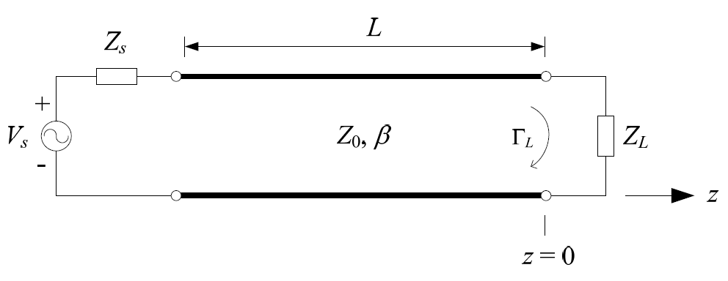
Voltage on T. Line

Slide 17
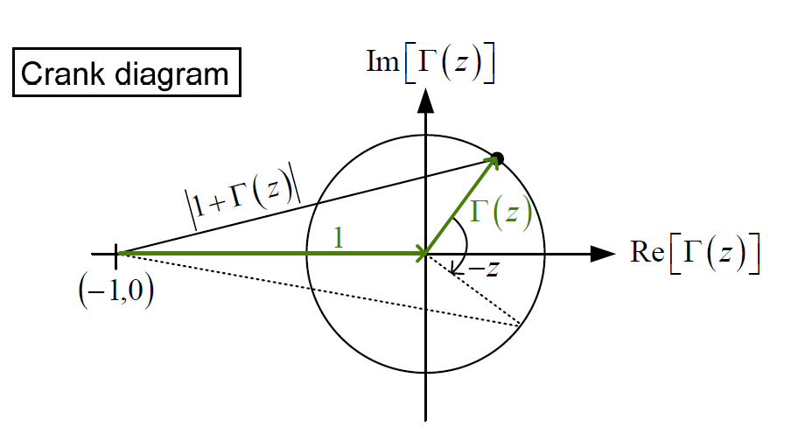
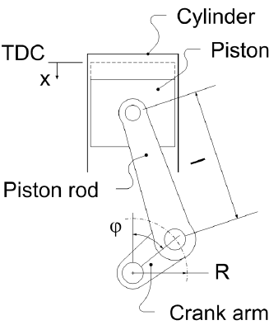
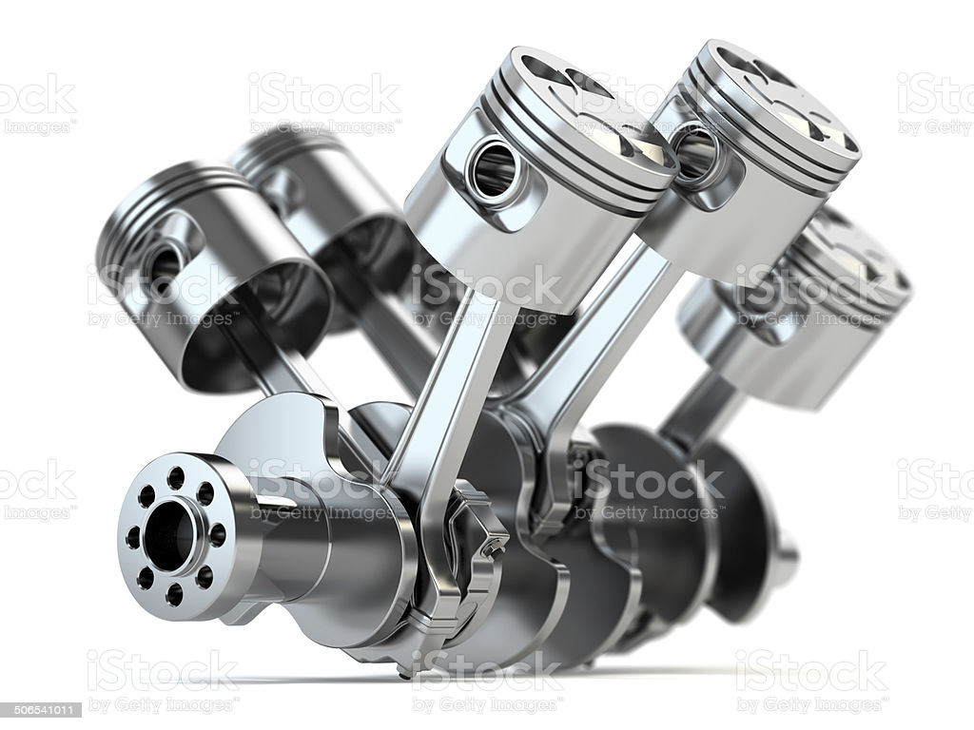
Reflection Coefficient on T. Line
Repeats itself every half wavelength
Crank inside a car engine

Slide 18
T. Line Terminated with Short or Open
From Agilent
Zs = Zo
V
inc
Vrefl
In-phase (0º) for open,
out-of-phase (180º) for short
For reflection, a transmission line terminated in a short or open reflects all power back to source

Slide 19
T. Line Terminated with a Resistor
From Agilent
Zs = Zo
ZL = 25 Ω
V
inc
Vrefl
Standing wave pattern does not go to zero as with short or open

Slide 20
Input Impedance

Slide 21
Smith Chart
How do we graph these?

Slide 22
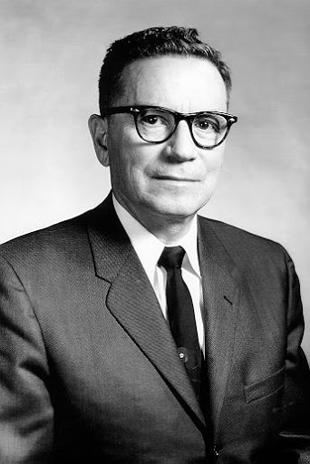
Smith Chart
Invented in 1939 By Philip Smith at Bell Labs

Slide 23
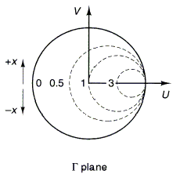
Smith Chart
Normalized Impedance
x
?
1
2
3
r
Constant resistance lines mapped onto circles

Slide 24
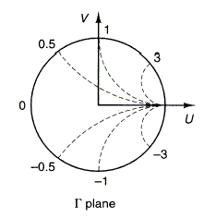
Smith Chart
x
Inductive
Inductive
j1
r
Capacitive
Capacitive
Constant reactance lines mapped onto arches

Slide 25
Smith Chart

Slide 26
Smith Chart
A load impedance of 130 +j90 Ω terminates a 50 Ω T. Line that is 0.3 λ long. Find:
The reflection coefficient at the load
The reflection coefficient at the input to the line
The input impedance
SWR on the line
The return loss.
Z₀=50 Ω
Z_{L} = 130 +j90 Ω
0.3 λ

Slide 27
Smith Chart
Z_{L} = 130 +j 90 Ω
What is the reflection coefficient?
Step 1 – Convert to normalized impedance.
z_{l} = 130/50+j 90/50 Ω
Step 2 – plot on chart
Step 3 – measure how far from edge.
This tells |Γ|
Step 4 – measure angle θ from angle from center axis.
Γ =|Γ|e ^{j θ} = .6e^{j21.8°}
z_{L}
|Γ| = .60
θ = 21.8 °
Z_{L} = 130 +j 90 Ω

Slide 28
Smith Chart
Z_{L} = 130 +j90 Ω
What is the reflection coefficient .3λ down the line?
Step 1– Convert to normalized impedance.
z_{l} = 130/50+j 90/50 Ω
Step 2 – plot on chart
Step 3 – move around constant |Γ| circle a distance βl
Step 4 - λ/2 = 1 rotation so .3λ = .6 the way around.
Step 5 – read off z_{l}’, (new position) and convert to Z_{in}. Z_{in} = (.255+j.117)Z_{o}
Zl’
z_{L}
l = .3λ
|Γ| = ?
θ = ?°
Z_{L} = 130 +j90 Ω

Slide 29
Smith Chart
Zl’
z_{L}
ZL = 130 +j 90 Ω
What is the input impedance and reflection coefficient .3λ down the line?
Step 5 – read off z_{l}’, (new position) and convert to Z_{in}. Z_{in} = (.255+j.117)Z_{o}
Z_{in} = 12.7 + j5.8
Step 6 – read off Gamma from polar coordinates –
Γ =|Γ|e^{jθ}=|Γ|e^{j165.8°}
l = .3λ
|Γ| = .60
θ = 156.8 °
Z_{L} = 130 +j90 Ω

Slide 30
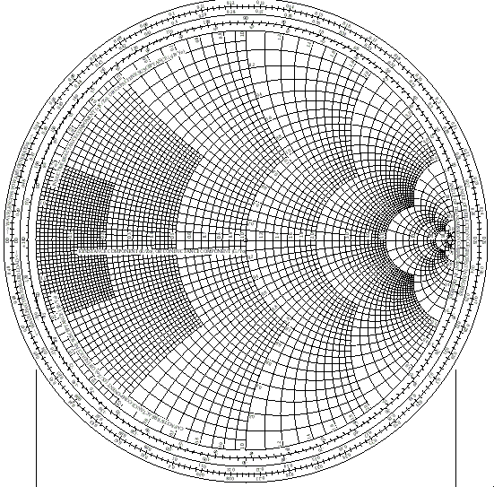
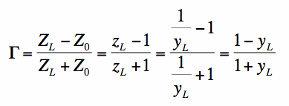



Admittance Chart
From impedance to admittance chart is simply moving 180 degrees from the load.
Z_{L} = 100+ j 50 = Z_{o} *(2+j1)
Z_{in}
j100
100
Z0=50Ω, 0.12λ
-j150
Z0=50Ω, 0.15λ
j60
Y_{L}=1/Z_{L} = G + j B

Slide 31
Useful Website
https://www.microwaves101.com/

